Slide 1


Designing QDAS to increase access:
Design philosophies from Quirkos
Dr Daniel Turner
daniel@quirkos.com
www.quirkos.com
Notes:
<number>

Slide 2

A growing qualitative world?
British PhDs using qualitative
methods doubled in 10 yrs
Increasing use of QDA software (Jackson 2016)
More mixed method disciplines
Increasing interest from ‘emerging economies’

Slide 3
How to keep QDAS accessible?
Features converging in major packages
(Di Gregorio 2011)
Interfaces little changed in 20 yrs
More people doing less qualitative work?
Changes in digital landscape (tablets, laptops)

Slide 4

Pedagogy first
Most training done by lecturers
Difficult to teach CAQDAS
(Gibbs 2014, Blank 2004)
Needs to fit into 2hr session
Students want to be self-taught

Slide 5
Space for something different
Easier to use (only basic features)
Easier to teach and learn (in 2hr session)
More visual approach
Identical cross platform support

Slide 6
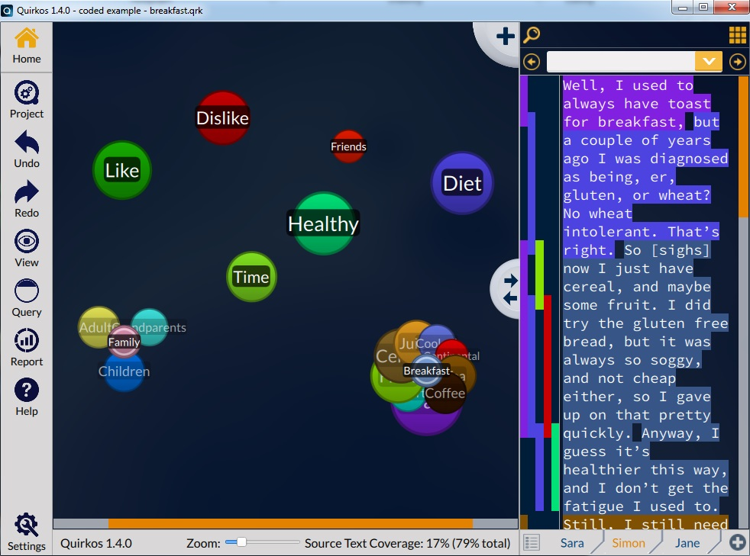

Slide 7
Live visual interface
Interface is visualisation – constant feedback
Students can see data grow
Minimize steps to outputs
Identical across platforms

Slide 8
Flexible teaching resources
Video guides of different lengths
‘Bit-guides’
Different manuals
Free Monthly ‘Webinars’
Pre-made lecture slides!

Slide 9

One piece of a puzzle
CAQDAS always used with other software
Input Analyse Outputs

Slide 10

Pricing for accessibility
CAQDAS unaffordable
for ‘emerging nations’
(Haratyk and Kordasiewicz 2014)
Student licences that don’t expire (+4yr PhDs)
Lower cost (but fewer features)

Slide 11
Limitations
Very basic code & retrieve focus
No multimedia support
No quantitative analysis
Limited team / network support
Not designed for thousands of sources
No memos yet!!!

Slide 12

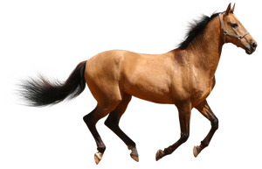
My First CAQDAS™
First steps…
For future power users?

Slide 13
Talking points!
Accessibility (vs Utility?)
Need to stick to limited feature plan
Aim to increase QDAS and qualitative field

Slide 14
Compatibility
Users and researchers deserve it!
Don’t have to support everything in v1.0
QuDEX? (via UKDA via Essex via Muhr)
But...

Slide 15
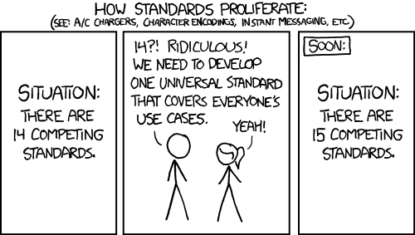
Compatibility

Slide 16
Accessibility first!
Questions or feedback?
www.quirkos.com
daniel@quirkos.com
Twitter: quirkossoftware

